Slide 1
Ticket Price and Facility Value Analysis
Big Mountain Resort

Slide 2
Problem Identification
Problem Statement
What is a fair price to charge?
What facilities should Big Mountain invest/divest to increase the ticket price?
Criteria for Success
Develop a data driven recommendation on ticket price based on current market rates
Identify at least 1 investment/divestment opportunity that would bring up ticket price
Constraints
330 Observations –Resorts in the US
Customer preference may change over time
Stakeholders
Database Manager –Alesha Eisen
Director of Operations –Jimmy Blackburn

Slide 3
Recommendation and key findings
Increase ticket price from $81 to $100
Big Mountain Resort owns top tier facilities in areas including
Vertical Drop
Areas Covered by Snow Makers
Total Number of Chairs
Number of Fast Quads
Total Number of Runs
These above features are most influential to ticket price
Resorts with this level of facilities could charge $100 according to our analysis
Choose Scenario 3 to boost ticket value in the future
Increasing vertical drop by adding a run, installation of an additional chair lift, and adding 2 acres of snow making cover
Expected to increase ticket value by $11.26
Generates $20M additional revenue in the season
More info on operating cost is needed to further justify this decision

Slide 4
Modeling Results and Analysis-Linear Model
Variable | Coefficient
Vertical Drop | 10.78
Snow Making | 6.29
Total Chairs | 5.79
FastQuads | 5.75
Runs | 5.37
Longest Run | 0.18
Trams | -4.14
Skiable Terrain | -5.25
Insights
Fair Ticket Price $110
Likely to be +/- $10 off
Vertical Drop, Snow Making, Total Chairs is strongly and positively correlated with Adult Weekend ticket price
Consider to increase price by $29

Slide 5
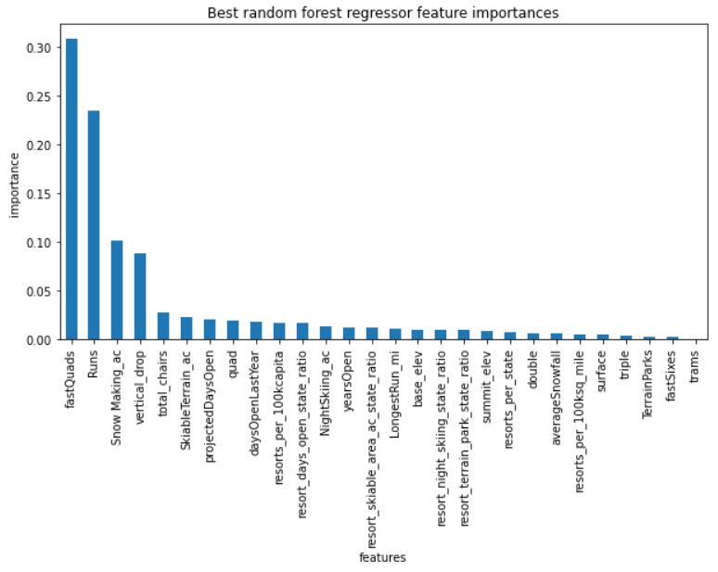
Modeling Results and Analysis-Random Forests
Insights
Fair Ticket Price $100
Likely to be $10 off
Feature importance order is consistent with the linear model
Consider to increase price by $19

Slide 6
Modeling Results and Analysis –Scenario Comparison
Close 1-10 least used runs
Closing 1 run makes no difference to ticket price
Closing 3-5 runs brings same effect to ticket price
Closing more than 6 leads to a big drop in ticket price
Increase vertical drop, add a run and a chair lift
Increases ticket price by $9
Generates around 16M additional revenue in the season
Increase vertical drop, add a run, a chair lift and snow making
Increases ticket price by $11
Bring is around $20M more revenue in this season
Increase longest run and Snow Making
No difference in ticket price

Slide 7
Summary and Conclusion
Big Mountain Resort should consider to increase ticket price by at $19
Big Mountains has outstanding facilities compared to other resorts in the market, especially in snow making areas and number of chairs
Scenario 3 would add more value to the ticket price
More information on operating costs is needed to develop further analysis on investment opportunities.

